Slide 1

How Kafka has Become the Nervous System of a Modern Data Architecture
Cliff Gilmore
Advanced Technology Group @ Confluent
cliff@confluent.io

Slide 2
What is Kafka?

Slide 3
apache kafka: a distributed streaming platform
scalability of a
filesystem
hundreds of MB/s
many TBs per server
commodity hardware
guarantees of a database
persistence
ordering
distributed by design
replication
partitioning
horizontal scalability
fault tolerance
Notes:
Kafka is motivated by that world view and is a distributed streaming platform.
Kafka is a cross between a pub-sub messaging system, a file system and a database.
It supports reads and writes with high throughput, stores many TBs per server like a file system, offers persistence and ordering like a database and is fully distributed by design.

Slide 4





Current Architecture
Web
Custom Apps
Microservices
Monitoring
Analytics
…and more
App
App
Caches
ActiveMQ
App
App
App
OLTP
OLTP
OLTP
Bloomberg
NoSQL
SFDC
Data Warehouse
Oracle
Hadoop
…any sink/source
Logging
Notes:
Most organizations are facing an explosion of data coming from new applications, new business opportunities, IoT, and more. The ideal architecture most envision is a clean, optimized system that allows businesses to capitalize on all that data.
However, traditional systems used for solving these problems were designed in an era that predates large-scale distributed systems, and lack the ability to scale to meet the needs of the modern data-driven organization.
This results in a giant, unorganized and difficult-to-access mess of an infrastructure.

Slide 5
Apache KafkaⓇ: A Distributed Streaming Platform
Web
Custom Apps
Microservices
Monitoring
Analytics
…and more
Apache Kafka
Bloomberg
NoSQL
SFDC
Data Warehouse
…any sink/source
Twitter
Oracle
Hadoop
…any sink/source
Notes:
Apache Kafka™ is a streaming platform designed to solve these problems in a modern, distributed architecture. Originally envisioned as a fast and scalable distributed messaging queue, it has rapidly expanded into a full-scale streaming platform, capable of not just publish-and-subscribe, but also storage and processing of data within the stream.

Slide 6
Producing to Kafka
Time
Notes:
At it’s simplest, Kafka can be described as an append only commit log. Data is appended to the end of the log.

Slide 7
Producing to Kafka
Time
C
C
C
Notes:
At it’s simplest, Kafka can be described as an append only commit log. Data is appended to the end of the log.

Slide 8
Producing to Kafka - No Key
Time
Messages will be produced in a round robin fashion

Slide 9
Producing to Kafka - With Key
Time
A
B
hash(key) % numPartitions = N
C
D

Slide 10
Consuming From Kafka - Single Consumer
C

Slide 11
Consuming From Kafka - Grouped Consumers
C
C
C1
C
C
C2

Slide 12
Consuming From Kafka - Grouped Consumers
C
C
C
C

Slide 13
Consuming From Kafka - Grouped Consumers
0
1
2
3

Slide 14
Kafka Streams

Slide 15
Simplifying Real Time Processing
Your App
Key Benefits of Apache Kafka’s Streams API
Build Apps, Not Clusters: no additional cluster required
Elastic, highly-performant, distributed, fault-tolerant, secure
Equally viable for small, medium, and large-scale use cases
“Run Everywhere”: integrates with your existing deployment strategies such as containers, automation, cloud
Part of open source Apache Kafka, introduced in 0.10+
Powerful client library to build stream processing apps
Apps are standard Java applications that run on client machines
https://github.com/apache/kafka/tree/trunk/streams
Streams API
Kafka
Cluster

Slide 16
What can I do with Streams?
Use Cases
Technical Fit
Customer 360
Fleet or inventory management
Fraud detection
Real-time monitoring & intelligence
Location-based marketing
Claims Processing
< Many More>
Microservices
Fast Data apps
Reactive applications
Continuous queries and transformations
Event-triggered processes
The “T” in ETL
<Many More>

Slide 17
Simple Architecture
Your Application or Service
Separate Streams Cluster
DB
Other Stream Platforms
Your “Job”
Your Application or Service
Kafka Streams

Slide 18
Streams & Tables – We Need Both!
Streams (KStream)
Many events flowing into a system continuously processed
individually or as a batch
Streaming Tables (KTable)
Reference data that is continuously
changed and updated based on a stream

Slide 19
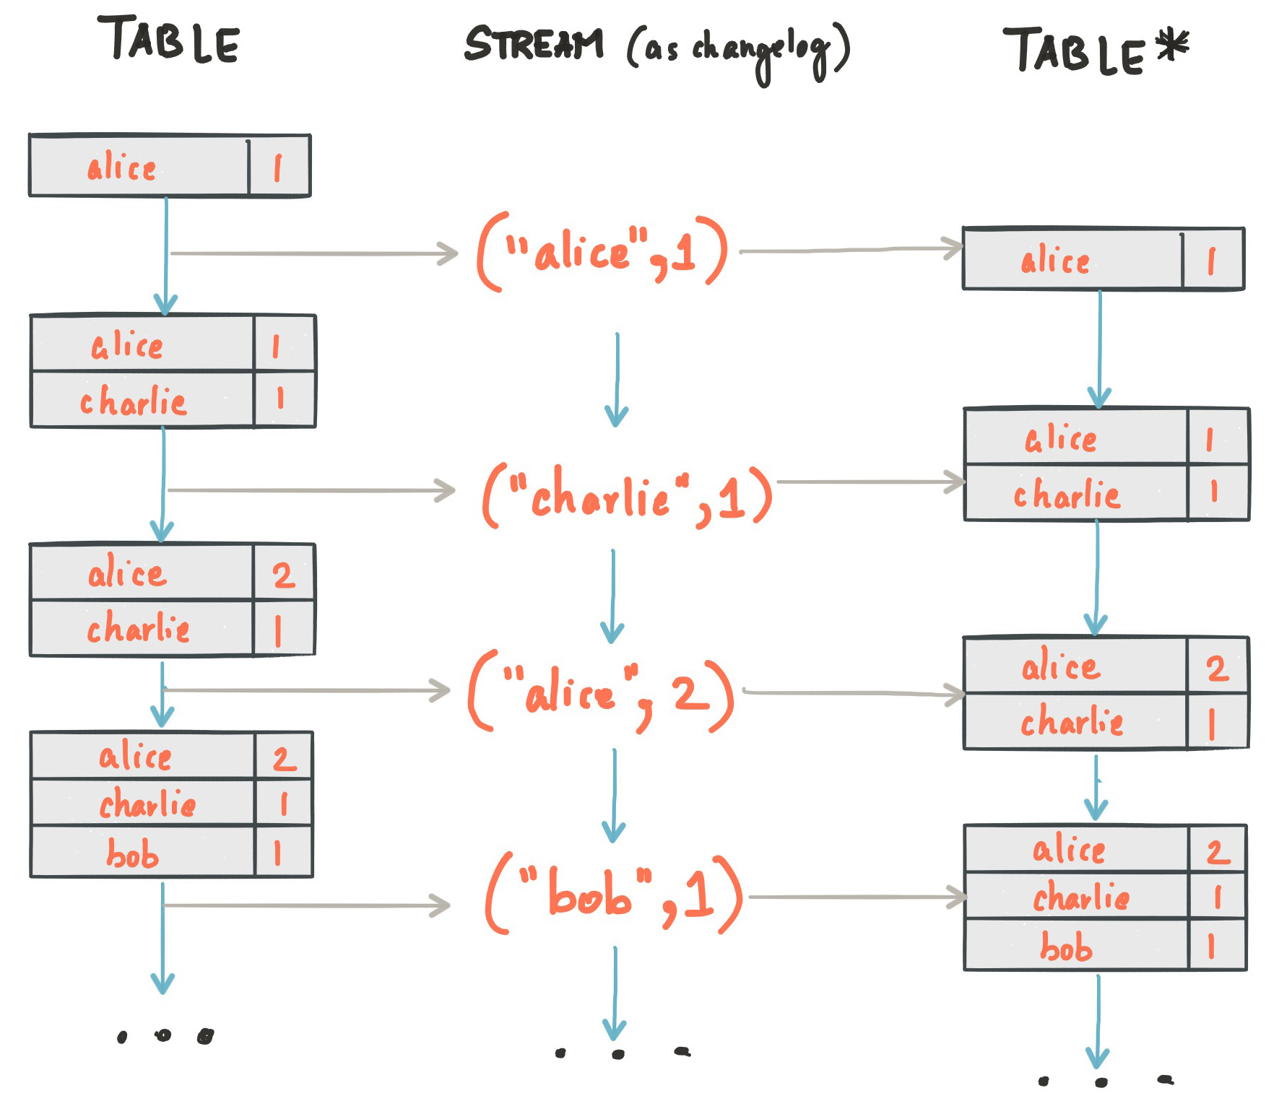
Streaming Table

Slide 20
API Choices
DSL
Processor
KStream<Integer, Integer> input = builder.stream("numbers-topic");
// Stateless computation
KStream<Integer, Integer> doubled = input.mapValues(v -> v * 2);
// Stateful computation
KTable<Integer, Integer> sumOfOdds = input .filter((k,v) -> v % 2 != 0) .selectKey((k, v) -> 1)
.groupByKey()
.reduce((v1, v2) -> v1 + v2, "sum-of-odds");
class PrintToConsoleProcessor implements Processor<K, V> {
@Override
public void init(ProcessorContext context) {}
@Override
void process(K key, V value) {
System.out.println("Got value " + value);
}
@Override
void punctuate(long timestamp) {}
@Override
void close() {}
}

Slide 21
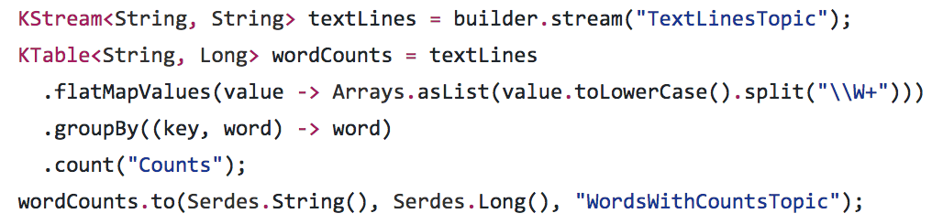
Word Count Example

Slide 22
Example Use Case

Slide 23
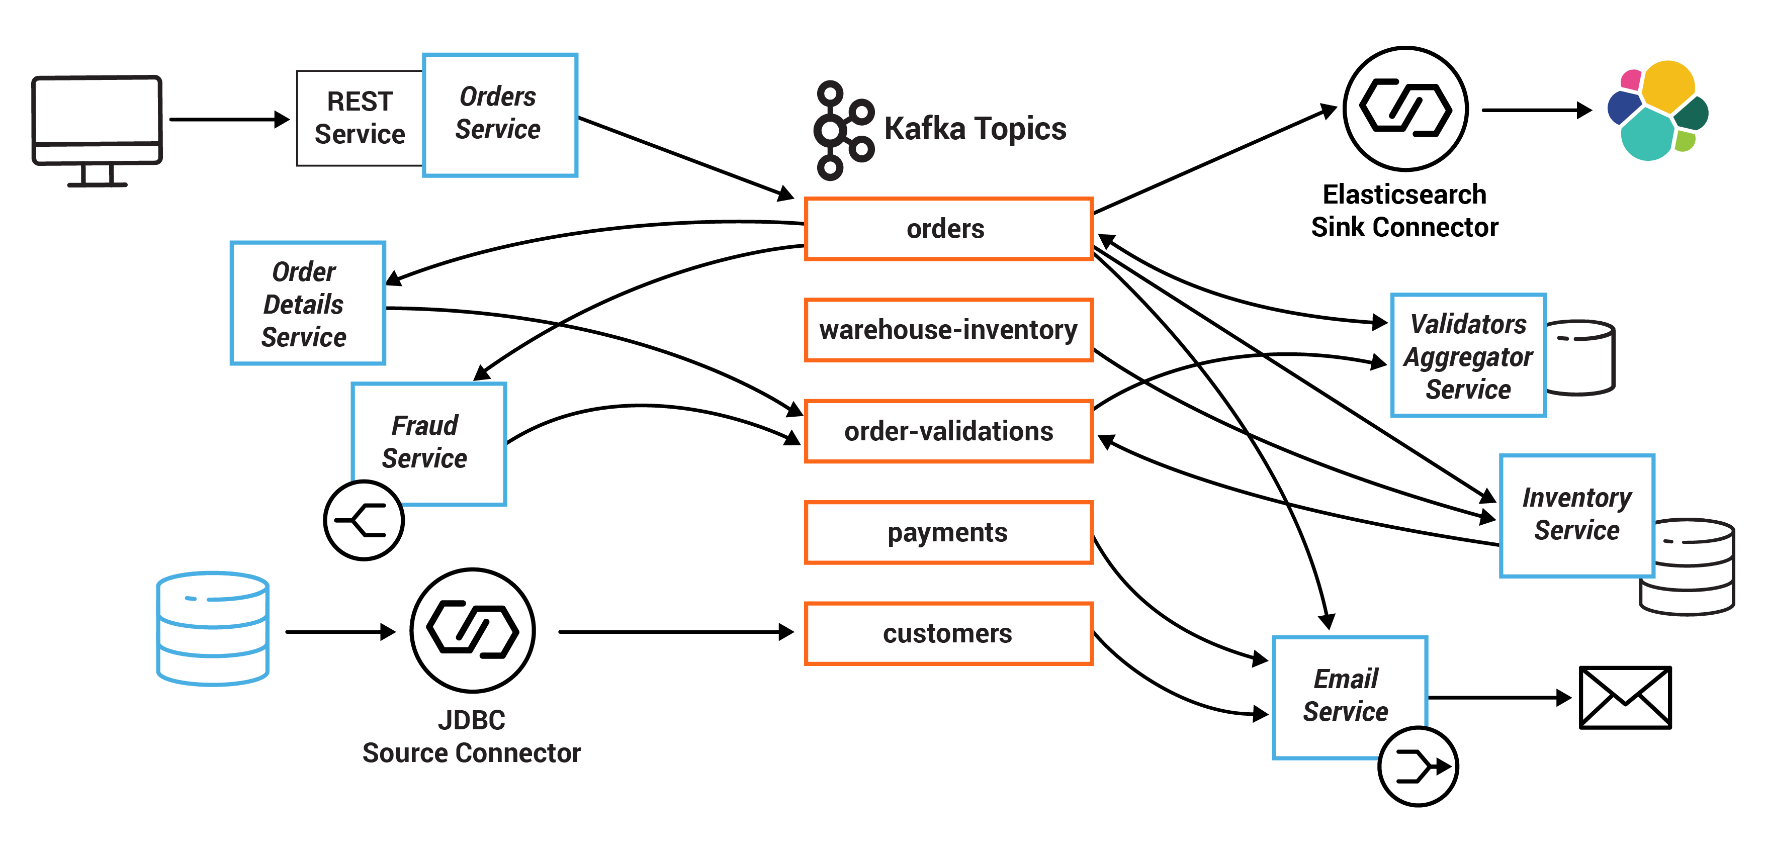
Retail Application Example

Slide 24
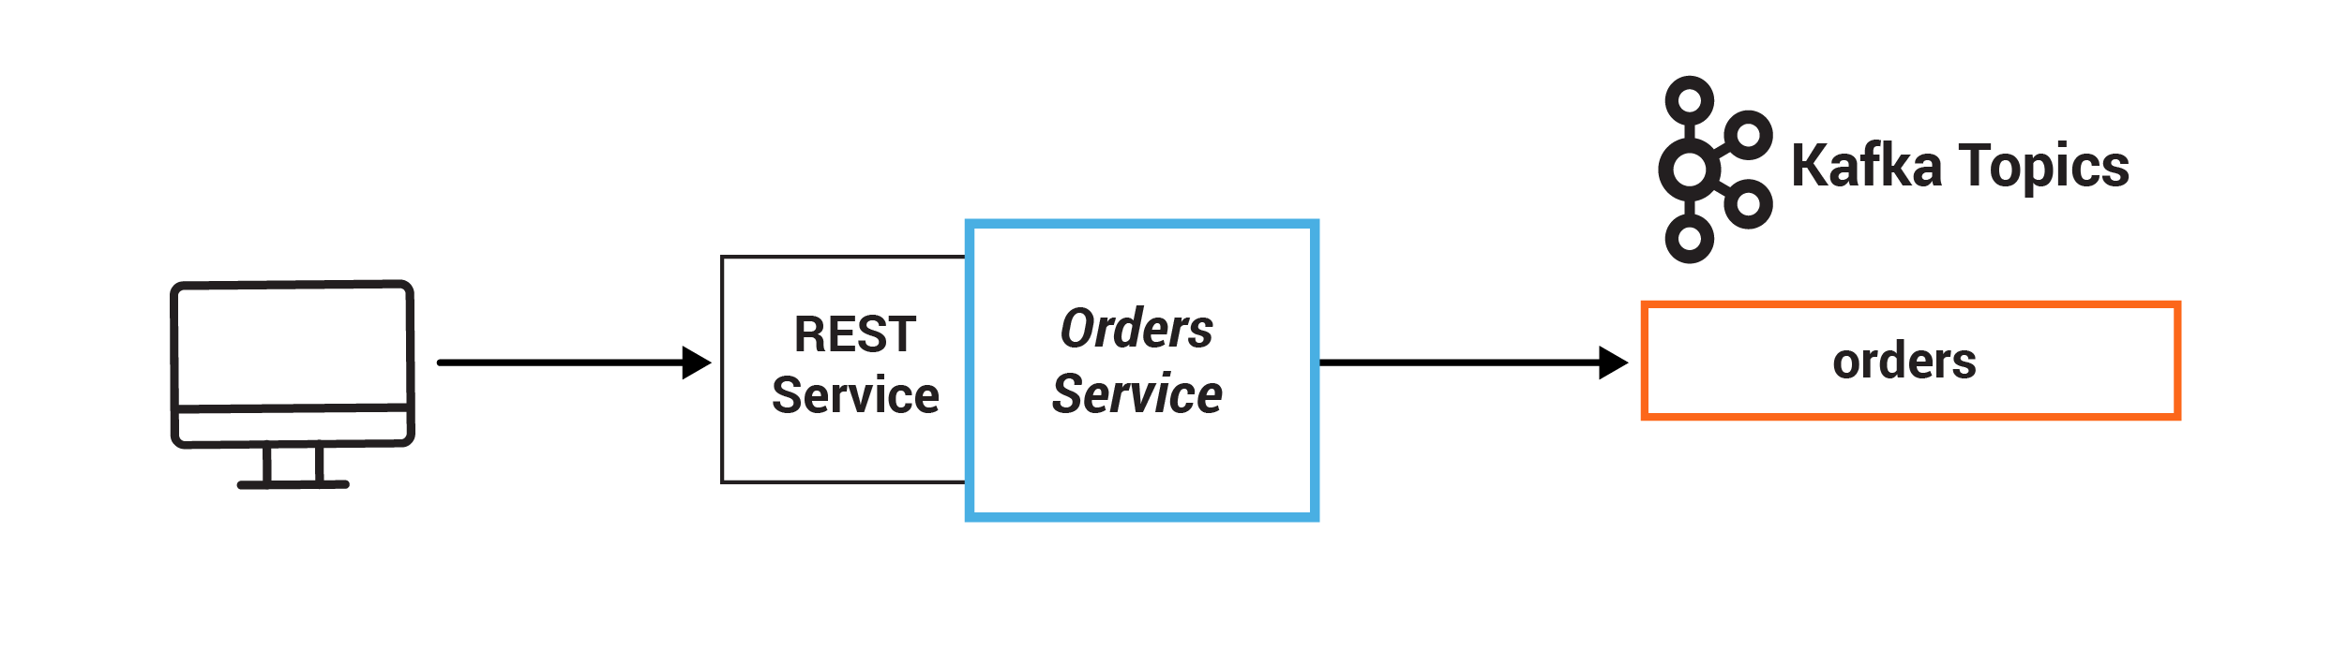
Retail Application Example

Slide 25
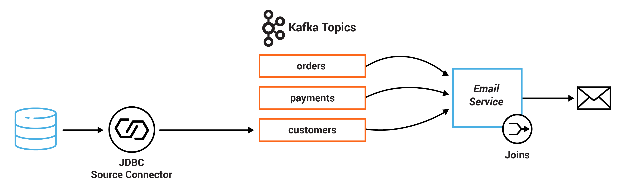
Retail Application Example

Slide 26
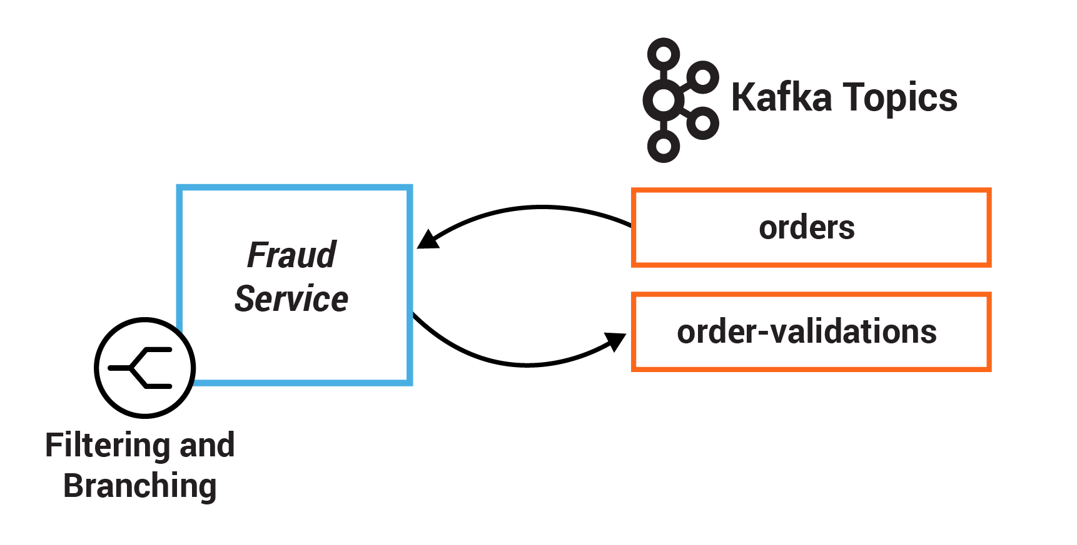
Retail Application Example

Slide 27
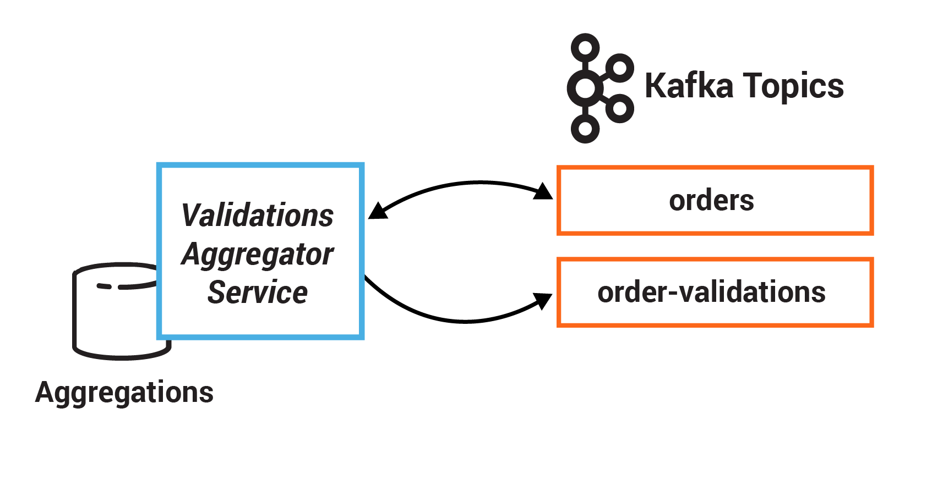
Retail Application Example

Slide 28
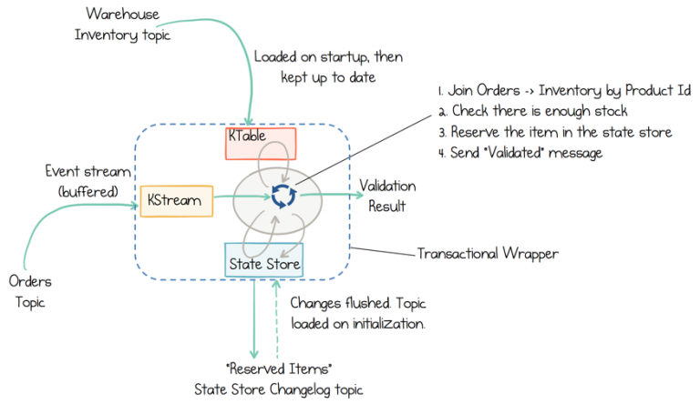
Retail Application Example

Slide 29
Thank You!

